Slide 1
More Code Optimization

Slide 2
Outline
More Code Optimization techniques
Optimization Limiting Factors
Memory Performance
Suggested reading
  5.8 ~ 5.12

Slide 3
Data-Flow Graphs
Data-Flow Graphs
  Visualize how the data dependencies in a program dictate its performance
  Example: combine4 (data_t = float, OP = *)
void combine4(vec_ptr v, data_t *dest)
{
long int i;
long int length = vec_length(v);
data_t *data = get_vec_start(v);
data_t x = IDENT;
for (i = 0; i < length; i++)
x = x OP data[i];
*dest = x;
}

Slide 4
Graphical Representation
%rax
%rbp
%rdx
%xmm0
load
mulss (%rax,%rdx,4), %xmm0
mul
add
t
addq $1,%rdx
cmp
cmpq %rdx,%rbp
jg
jg loop
cc
%rax
%rbp
%rdx
%xmm0
Registers
  read-only: %rax, %rcx
  write-only: -
  Loop: %rdx, %xmm0
  Local: t, cc
load (%rax,%rdx.0,4)➔ t.1
mulq t.1, %xmm0.0 ➔ %xmm0.1
addq $1, %rdx.0 ➔ %rdx.1
cmpq %rdx.1, %rbp ➔ cc.1
jg-taken cc.1

Slide 5
Refinement of Graphical Representation
%rax
%rbp
%rdx
%xmm0
Data Dependencies
load
mul
add
cmp
%xmm0
%rax
%rbp
%rdx
jg
%rax
%rbp
%rdx
%xmm0
load
add
mul
cmp
jg
%xmm0
%rdx

Slide 6
Refinement of Graphical Representation
%xmm0
%rdx
Data Dependencies
load
data[i]
add
mul
%xmm0
%rax
%rbp
%rdx
%xmm0
%rdx
load
add
mul
cmp
jg
%xmm0
%rdx

Slide 7
Refinement of Graphical Representation
%xmm0
%rdx
%xmm0.0
%rdx.0
load
data[i]
load
data[0]
add
add
mul
mul
%xmm0
%rdx
%xmm0.1
%rdx.1
load
data[1]
add
mul
%xmm0.2
%rdx.2

Slide 8
Refinement of Graphical Representation
load
data[0]
%xmm0.0
%rdx.0
add
mul
load
data[0]
add
mul
load
data[1]
add
%xmm0.1
%rdx.1
mul
load
data[1]
..
..
add
mul
load
data[n-1]
add
%xmm0.2
%rdx.2
mul

Slide 9
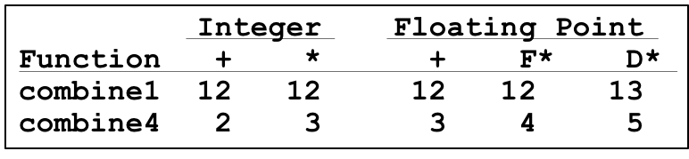
Refinement of Graphical Representation
data[0]
Two chains of data dependencies
  Update x by mul
  Update i by add
Critical path
  Latency of mul is 4
  Latency of add is 1
The latency of combine4 is 4
load
add
mul
load
data[1]
add
mul
..
..
load
data[n-1]
add
mul

Slide 10
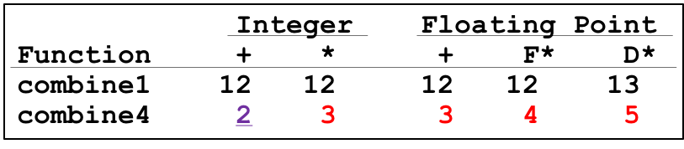
Performance-limiting Critical Path
  Nehalem (Core i7)
  Instruction Latency Cycles/Issue
    Integer Add 1 0.33
    Integer Multiply 3 1
    Integer/Long Divide 11--21 5--13
    Single/Double FP Add 3 1
    Single/Double FP Multiply 4/5 1
    Single/Double FP Divide 10--23 6--19

Slide 11
Other Performance Factors
Data-flow representation provide only a lower bound
  e.g. Integer addition, CPE = 2.0
  Total number of functional units available
  The number of data values can be passed among functional units
Next step
  Enhance instruction-level parallelism
  Goal: CPEs close to 1.0

Slide 12
Loop Unrolling
void combine5(vec_ptr v, int *dest)
{
int i;
int length = vec_length(v);
int limit = length - 2;
int *data = get_vec_start(v);
int x = IDENT;
/* combine 3 elements at a time */
for (i = 0; i < limit; i+=3)
x = x OPER data[i] OPER data[i+1] OPER data[i+2];
/* finish any remaining elements */
for (; i < length; i++)
x = x OPER data[i];
*dest = x;
}

Slide 13
Translation
Loads can pipeline, since don’t have dependencies
Only one set of loop control operations
load (%rax,%rdx.0,4) ➔ t.1a
addq t.1a, %rcx.0c ➔ %rcx.1a
load 4(%rax,%rdx.0,4) ➔ t.1b
addq t.1b, %rcx.1a ➔ %rcx.1b
load 8(%rax,%rdx.0,4) ➔ t.1c
addq t.1c, %rcx.1b ➔ %rcx.1c
addq $3,%rdx.0 ➔ %rdx.1
cmpq %rdx.1, %rbp ➔ cc.1
jg-taken cc.1

Slide 14
Graphical Representation
%rax
%rbp
%rdx
%xmm0
load
addq (%rax,%rdx,4), %xmm0
add
load
t.a
addq 4(%rax,%rdx,4), %xmm0
add
load
t.b
addq 8(%rax,%rdx,4), %xmm0
add
add
t.c
addq $3,%rdx
cmp
cmpq %rdx,%rbp
jg
jg loop
cc
%rax
%rbp
%rdx
%xmm0

Slide 15
Graphical Representation
%xmm0
%rax
%rbp
%rdx
%xmm0
%rdx
load
load
data[i]
add
add
load
data[i+1]
load
add
load
data[i+2]
add
add
add
load
add
add
%xmm0
%rdx
cmp
jg
%xmm0
%rdx

Slide 16
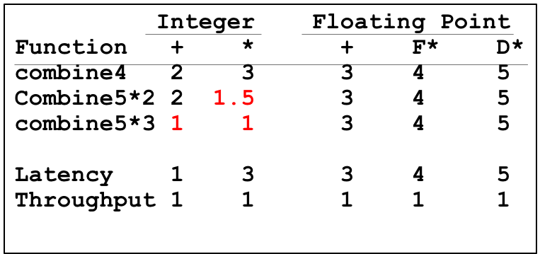
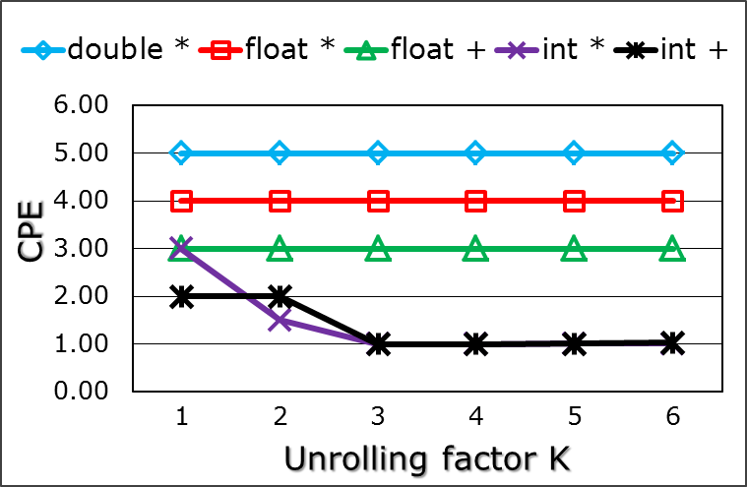
Graphical Representation
load
data[0]
add
load
data[1]
add
load
data[2]
add
add
load
data[3]
add
load
data[4]
add
load
data[5]
add
add

Slide 17
Loop Unrolling
Improve performance
  Reduces the number of operations
  (e.g. loop indexing and conditional branching)
  Transform the code to reduce the number of operations in the critical paths
CPEs for both integer ops improve
But for both floating-point ops do not

Slide 18
Effect of Unrolling
load
data[i]
load
data[i]
mul
add
load
data[i+1]
load
data[i+1]
add
load
data[i+2]
mul
add
add
load
data[i+2]
Critical path
  Latency of integer add is 1
  Latency of FP multiplex is 4
mul
add

Slide 19
Effect of Unrolling
Only helps integer sum for our examples
  Other cases constrained by functional unit latencies
Effect is nonlinear with degree of unrolling
  Many subtle effects determine exact scheduling of operations

Slide 20
Enhance Parallelism
Multiple Accumulators
  Accumulate in two different sums
    Can be performed simultaneously
  Combine at end

Slide 21
Multiple Accumulator
void combine6(vec_ptr v, int *dest)
{
int i;
int length = vec_length(v), limit = length-1;
int *data = get_vec_start(v);
int x0 = IDENT, x1 = IDENT;
/* combine 2 elements at a time */
for (i = 0; i < limit; i+=2){
x0 = x0 OPER data[i];
x1 = x1 OPER data[i+1];
}
/* finish any remaining elements */
for (; i < length; i++)
x0 = x0 OPER data[i];
*dest = x0 OPER x1;
}

Slide 22
Translation
Two multiplies within loop no longer have data dependency
Allows them to pipeline
load (%rax,%rdx.0,4) ➔ t.1a
mulq t.1a, %xmm0.0 ➔ %xmm0.1
load 4(%rax,%rdx.0,4) ➔ t.1b
mulq t.1b, %xmm1.0 ➔ %xmm1.1
addq $2,%rdx.0 ➔ %rdx.1
cmpq %rdx.1, %rbp ➔ cc.1
jg-taken cc.1

Slide 23
Graphical Representation
%rax
%rbp
%rdx
%xmm0
%xmm1
load
mulss (%rax,%rdx,4), %xmm0
mul
t.a
load
mulss 4(%rax,%rdx,4), %xmm1
mul
add
t.b
addq $2,%rdx
cmp
cmpq %rdx,%rbp
jg
jg loop
cc
%rax
%rbp
%rdx
%xmm0
%xmm1

Slide 24
Graphical Representation
%xmm0
%rax
%xmm1
%rbp
%rdx
%xmm0
%xmm1
%rdx
load
data[i]
load
load
load
mul
mul
add
data[i+1]
add
mul
mul
cmp
%xmm0
%xmm1
%rdx
jg
%xmm0
%xmm1
%rdx

Slide 25
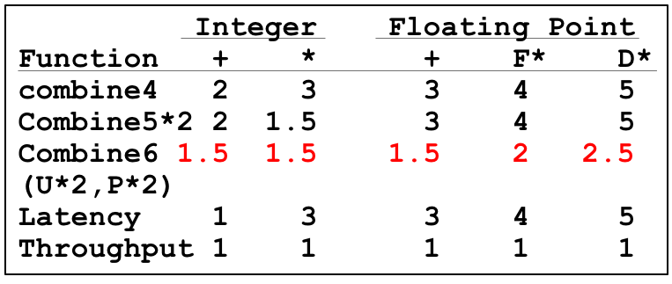
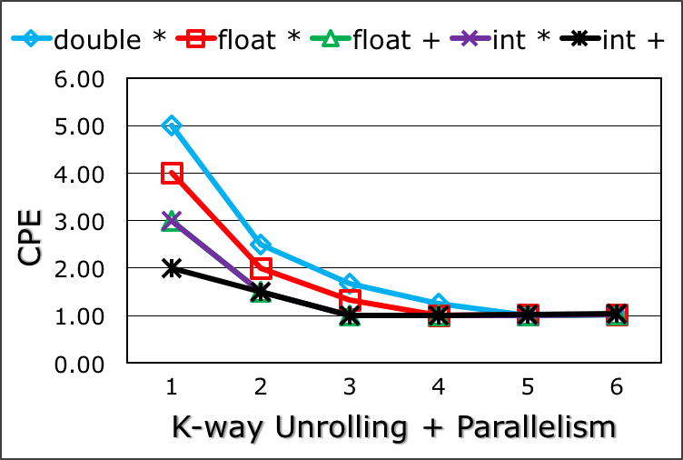
Graphical Representation
load
data[0]
load
mul
add
data[1]
mul
load
data[2]
load
mul
add
data[3]
mul
..
..
..
load
data[n-2]
load
mul
add
data[n-1]
mul

Slide 26
Enhance Parallelism
Multiple Accumulators
  Accumulate in two different sums
    Can be performed simultaneously
  Combine at end
Re-association Transformation
  Exploits property that integer addition & multiplication are associative & commutative
  FP addition & multiplication not associative, but transformation usually acceptable

Slide 27
Re-association Transformation
void combine7(vec_ptr v, int *dest)
{
int i;
int length = vec_length(v), limit = length-1;
int *data = get_vec_start(v);
int x = IDENT;
/* combine 2 elements at a time */
for (i = 0; i < limit; i+=2){
x = x OPER (data[i] OPER data[i+1]);
}
/* finish any remaining elements */
for (; i < length; i++)
x0 = x0 OPER data[i];
*dest = x0 OPER x1;
}

Slide 28
Translation
Two multiplies within loop no longer have data dependency
Allows them to pipeline
load (%rax,%rdx.0,4) ➔ xmm0.0
load 4(%rax,%rdx.0,4) ➔ t.1
mulq t.1, %xmm0.0 ➔ xmm0.1
mulq %xmm0.1, %xmm1.0 ➔ xmm1.1
addq $2,%rdx.0 ➔ %rdx.1
cmpq %rdx.1, %rbp ➔ cc.1
jg-taken cc.1

Slide 29
Graphical Representation
%rax
%rbp
%rdx
%xmm0
%xmm1
load
movss (%rax,%rdx,4), %xmm0
load
mulss 4(%rax,%rdx,4), %xmm0
mul
t
mul
mulss %xmm0, %xmm1
add
addq $2,%rdx
cmp
cmpq %rdx,%rbp
jg
jg loop
cc
%rax
%rbp
%rdx
%xmm0
%xmm1

Slide 30
Graphical Representation
%xmm1
%rax
%rbp
%rdx
%xmm1
%rdx
load
load
load
load
data[i]
mul
add
mul
add
data[i+1]
cmp
mul
mul
jg
%xmm0
%rdx
%xmm0
%rdx

Slide 31
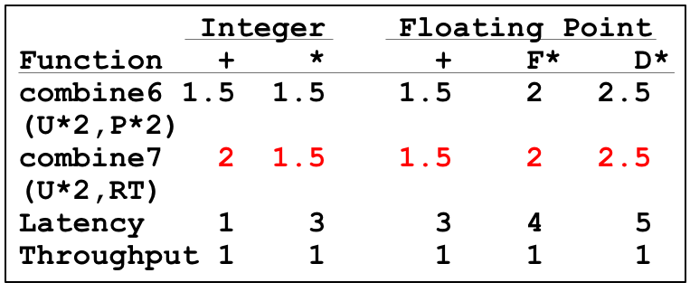
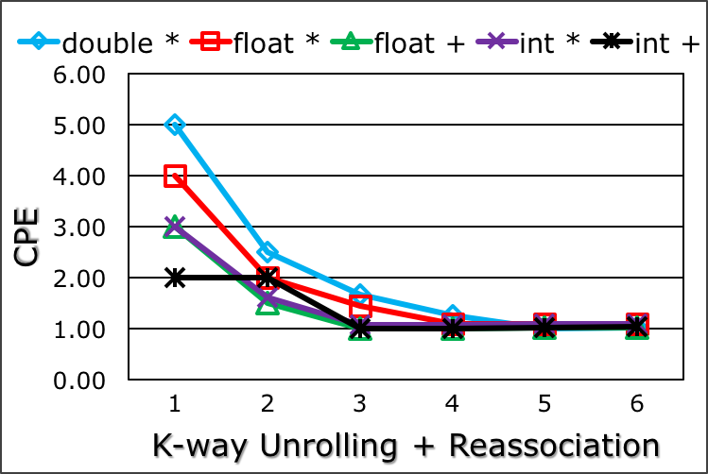
Graphical Representation
load
load
data[0]
mul
add
data[1]
mul
load
load
data[2]
mul
add
data[3]
mul

Slide 32
Summary of Results
Optimization Results for Combining
  Archive a CPE close to 1.0 for all combinations
  Performance improvement of over 10X
Machine Indep. Opts
Eliminating loop inefficiencies
Reducing procedure calls
Eliminating unneeded memory references
Machine dep. Opts
Loop Unrolling
Multiple Accumulator
Reassociation
Integer Floating Point
Function + * + F* D*
combine1 12 12 12 12 13
combine6 1.5 1.5 1.5 2 2.5
(U*2,P*2)
combine6 1 1 1 1 1
(U*5,P*5)
Latency 1 3 3 4 5
Throughput 1 1 1 1 1

Slide 33
Optimization Limiting Factors
Register spilling
  Only 6 registers available (IA32)
  Using stack(memory) as storage
Degree of Unrolling
Machine 1 2 3 4 5 6
IA32 2.12 1.76 1.45 1.39 1.90 1.99
X86-64 2.00 1.50 1.00 1.00 1.01 1.00

Slide 34
Example
IA32 code. Unroll X5, accumulate X5
data_t = int, OP = +, i in %edx, data in %eax, limit at %ebp-20
.L291:
imull
movl
imull
movl
imull
imull
movl
imull
movl
addl
cmpl
jg
loop:
x0 = x0 * data[i]
Get x1
x1 = x1 * data[i+1]
Store x1
x2 = x2 * data[i+2]
x3 = x3 * data[i+3]
Get x4
x4 = x4 * daa[i+4]
Store x4
i+= 5
Compare limit:i
If >, goto loop
(%eax,%edx,4), %ecx
-16(%ebp), %ebx
4(%eax,%edx,4), %ebx
%ebx, -16(%ebp)
8(%eax,%edx,4), %edi
12(%eax,%edx,4), %esi
-28(%ebp), %ebx
16(%eax,%edx,4), %ebx
%ebx, -28(%ebp)
$5, %edx
%edx, -20(%ebp)

Slide 35
Optimization Limiting Factors
Register Spilling
  Only 6 registers available (IA32)
  Using stack(memory) as storage
Branch Prediction
  Speculative Execution
  Misprediction Panelties

Slide 36
Branch Prediction
Challenges
  Instruction Control Unit must work well ahead of Exec. Unit
  To generate enough operations to keep EU busy
Speculative Execution
  Guess which way branch will go
  Begin executing instructions at predicted position
    But don’t actually modify register or memory data

Slide 37
Example: Loop
80488b1: movl (%ecx,%edx,4),%eax
80488b4: addl %eax,(%edi)
80488b6: incl %edx
80488b7: cmpl %esi,%edx
80488b9: jl 80488b1
80488be: movl (%ecx,%edx,4),%eax
Branch Not-Taken
Branch Taken
80488b1: movl (%ecx,%edx,4),%eax
80488b4: addl %eax,(%edi)
80488b6: incl %edx
80488b7: cmpl %esi,%edx
80488b9: jl 80488b1

Slide 38
Branch Prediction Through Loop
80488b1: movl (%ecx,%edx,4),%eax
80488b4: addl %eax,(%edi)
80488b6: incl %edx
80488b7: cmpl %esi,%edx
80488b9: jl 80488b1
Assume vector length = 100
i = 98
Predict Taken (OK)
80488b1: movl (%ecx,%edx,4),%eax
80488b4: addl %eax,(%edi)
80488b6: incl %edx
80488b7: cmpl %esi,%edx
80488b9: jl 80488b1
i = 99
Predict Taken
(Oops)
80488b1: movl (%ecx,%edx,4),%eax
80488b4: addl %eax,(%edi)
80488b6: incl %edx
80488b7: cmpl %esi,%edx
80488b9: jl 80488b1
Executed
Read invalid location
i = 100
Fetched
80488b1: movl (%ecx,%edx,4),%eax
80488b4: addl %eax,(%edi)
80488b6: incl %edx
80488b7: cmpl %esi,%edx
80488b9: jl 80488b1
i = 101

Slide 39
Branch Misprediction Invalidation
80488b1: movl (%ecx,%edx,4),%eax
80488b4: addl %eax,(%edi)
80488b6: incl %edx
80488b7: cmpl %esi,%edx
80488b9: jl 80488b1
Assume vector length = 100
i = 98
Predict Taken (OK)
80488b1: movl (%ecx,%edx,4),%eax
80488b4: addl %eax,(%edi)
80488b6: incl %edx
80488b7: cmpl %esi,%edx
80488b9: jl 80488b1
i = 99
Predict Taken
(Oops)
80488b1: movl (%ecx,%edx,4),%eax
80488b4: addl %eax,(%edi)
80488b6: incl %edx
80488b7: cmpl %esi,%edx
80488b9: jl 80488b1
i = 100
Invalidate
80488b1: movl (%ecx,%edx,4),%eax
80488b4: addl %eax,(%edi)
80488b6: incl %edx
80488b7: cmpl %esi,%edx
80488b9: jl 80488b1
i = 101

Slide 40
Branch Misprediction Invalidation
80488b1: movl (%ecx,%edx,4),%eax
80488b4: addl %eax,(%edi)
80488b6: incl %edx
80488b7: cmpl %esi,%edx
80488b9: jl 80488b1
Assume vector length = 100
i = 98
Predict Taken (OK)
80488b1: movl (%ecx,%edx,4),%eax
80488b4: addl %eax,(%edi)
80488b6: incl %edx
80488b7: cmpl %esi,%edx
80488b9: jl 80488b1
80488be: movl (%ecx,%edx,4),%eax
i = 99
Definitely not taken

Slide 41
Branch Misprediction Recovery
Performance Cost
  Misprediction on Core i7 wastes ~44 clock-cycle
  Don’t be overly concerned about predictable branches
    E.g. loop-closing branches would typically be predicted as being taken, and only incur a misprediction penalty on the last time around

Slide 42
void minmax1(int a[],
int b[], int n)
{
int i;
for (i = 0; i < n; i++) {
if (a[i] > b[i]) {
int t = a[i];
a[i] = b[i];
b[i] = t;
}
}
}
Write Suitable Code
void minmax2(int a[],
int b[], int n)
{
int i;
for (i = 0; i < n; i++) {
int min = a[i]<b[i]?a[i]:b[i];
int max = a[i]<b[i]?b[i]:a[i];
a[i] = min;
b[i] = max;
}
}
Function random predictable
minmax1 14.5 3.0-4.0
minmax2 5.0 5.0

Slide 43
Instruction Control
Fetch
Control
Address
Instruction
Cache
Retirement
Unit
Register
File
Instruction
Decode
Instructions
Operations
Register Updates
Prediction OK?
Execution
Functional
Units
Integer/
Branch
General
Integer
FP
Add
FP
Mult/Div
Load
Store
Operation Results
Addr.
Addr.
Data
Data
Data
Cache

Slide 44
Load Performance
load unit can only initiate one load operation every clock cycle (Issue=1.0)
typedef struct ELE {
struct ELE *next ;
int data ;
} list_ele, *list_ptr ;
int list_len(list_ptr ls) {
int len = 0 ;
while (ls) {
len++ ;
ls = ls->next;
}
return len ;
}
len in %eax, ls in %rdi
.L11:
addl $1, %eax
movq (%rdi), %rdi
testq %rdi, %rdi
jne .L11
Function CPE
list_len 4.0
load latency 4.0

Slide 45
Store Performance
store unit can only initiate one store operation every clock cycle (Issue=1.0)
void array_clear_4(int *dest, int n)
{
int i;
int limit = n-3;
for (i = 0; i < limit; i+=4) {
dest[i] = 0;
dest[i+1] = 0;
dest[i+2] = 0;
dest[i+3] = 0;
}
for ( ; i < n; i++)
dest[i] = 0;
}
Function CPE
array_clear_4 1.0

Slide 46
Store Performance
void write_read(int *src,
int *dest, int n)
{
int cnt = n;
int val = 0;
while (cnt--) {
*dest = val;
val = (*src)+1;
}
}
Example A: write_read(&a[0],&a[1],3)
initial
initial
initial
initial
cnt
3
2
1
0
a
-10
17
-10
0
-10
-9
-10
-9
val
0
-9
-9
-9
Example B: write_read(&a[0],&a[0],3)
initial
initial
initial
initial
cnt
3
2
1
0
Function CPE
Example A 2.0
Example B 6.0
a
-10
17
0
17
1
17
2
17
val
0
1
2
3

Slide 47
Load and Store Units
Load
Unit
Store Unit
Store buffer
address
data
address
Matching
addresses
Data
Address
Data
Address
Data
Data Cache

Slide 48
Graphical Representation
%eax
%ebx
%ecx
%edx
s_addr
movl %eax,(%ecx)
s_data
load
movl (%ebx), %eax
t
add
addl $1,%eax
sub
subl $1,%edx
jne
jne loop
%eax
%ebx
%ecx
%edx
//inner-loop
while (cnt--) {
*dest = val;
val = (*src)+1;
}

Slide 49
Graphical Representation
%eax
%ebx
%ecx
%edx
%eax
%edx
1
s_addr
s_data
s_data
2
load
3
load
sub
add
sub
add
jg
%eax
%edx
%eax
%edx

Slide 50
Graphical Representation
Example A
Example B
Critical Path
s_data
s_data
load
load
add
sub
add
sub
Function CPE
Example A 2.0
Example B 6.0
s_data
s_data
load
load
add
sub
add
sub
Notes:
Dependence on addresses of store and load

Slide 51
Getting High Performance
Good compiler and flags
Don’t do anything stupid
  Watch out for hidden algorithmic inefficiencies
  Write compiler-friendly code
    Watch out for optimization blockers:
    procedure calls & memory references
  Look carefully at innermost loops
Tune code for machine
  Exploit instruction-level parallelism
  Avoid unpredictable branches
  Make code cache friendly

